Slide 1
CPU SCHEDULING

Slide 2
Basic Concepts
In a single-processor system, only one process can run at a time. Others must wait until the CPU is free and can be rescheduled.
The objective of multiprogramming is to have some process running at all times, to maximize CPU utilization.
The idea is relatively simple. A process is executed until it must wait, typically for the completion of some I/O request. In a simple computer system, the CPU then just sits idle. All this waiting time is wasted; no useful work is accomplished.
With multiprogramming, we try to use this time productively. Several processes are kept in memory at one time. When one process has to wait, the operating system takes the CPU away from that process and gives the CPU to another process. This pattern continues. Every time one process has to wait, another process can take over use of the CPU.
Scheduling of this kind is a fundamental operating-system function.

Slide 3
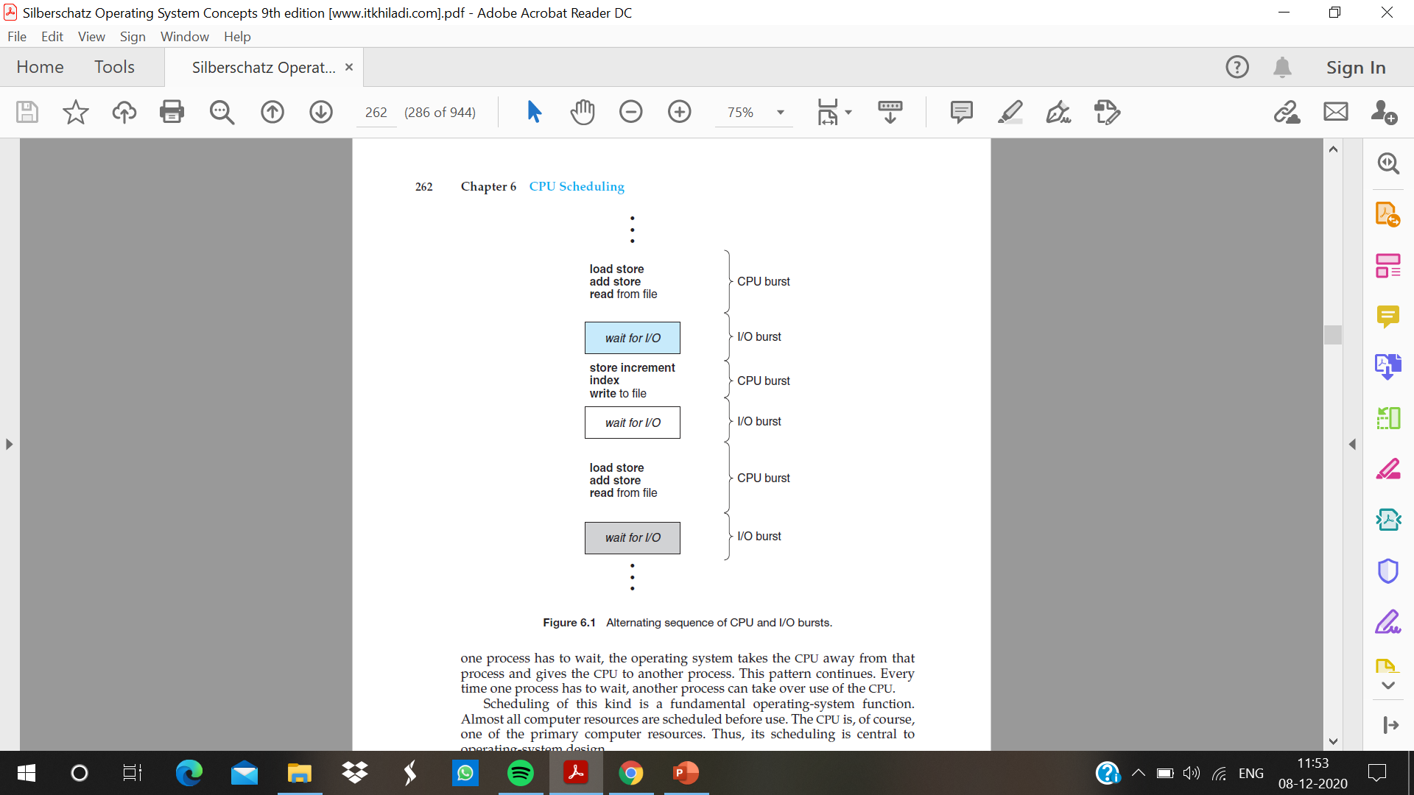

Slide 4
CPU–I/O Burst Cycle
process execution consists of a cycle of CPU execution and I/O wait. Processes alternate between these two states.
Process execution begins with a CPU burst. That is followed by an I/O burst, which is followed by another CPU burst, then another I/O burst, and so on. Eventually, the final CPU burst ends with a system request to terminate execution
An I/O-bound program typically has many short CPU bursts. A CPU-bound program might have a few long CPU bursts

Slide 5
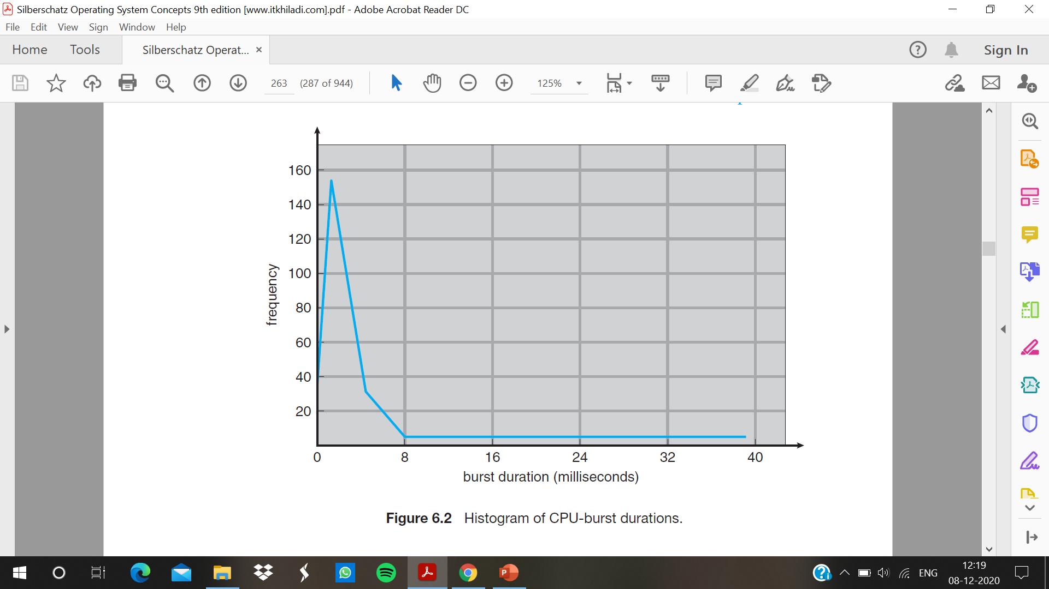

Slide 6
CPU Scheduler
Whenever the CPU becomes idle, the operating system must select one of the processes in the ready queue to be executed. The selection process is carried out by the short-term scheduler, or CPU scheduler. The scheduler selects a process from the processes in memory that are ready to execute and allocates the CPU to that process.
All the processes in the ready queue are lined up waiting for a chance to run on the CPU. The records in the queues are generally process control blocks (PCBs) of the processes.

Slide 7
CPU-scheduling decisions may take place under the following four circumstances:
1. When a process switches from the running state to the waiting state (for
example, as the result of an I/O request or an invocation of wait() for
the termination of a child process)
2. When a process switches from the running state to the ready state (for
example, when an interrupt occurs)
3. When a process switches from the waiting state to the ready state (for
example, at completion of I/O)
4. When a process terminates

Slide 8
Non-preemptive and preemptive scheduling
When scheduling takes place only under circumstances 1 and 4, the scheduling scheme is non preemptive or cooperative.
Otherwise, it is preemptive. Under non preemptive scheduling, once the CPU has been allocated to a process, the process keeps the CPU until it releases the CPU either by terminating or by switching to the waiting state. Eg: Microsoft Windows 3.x. Windows ,The Mac OS X
Cooperative scheduling is the only method that can be used on certain hardware platforms, because it does not require the special hardware (for example, a timer) needed for preemptive scheduling.
Unfortunately, preemptive scheduling can result in race conditions when data are shared among several processes. Consider the case of two processes that share data. While one process is updating the data, it is preempted so that the second process can run. The second process then tries to read the data, which are in an inconsistent state.

Slide 9
Dispatcher
The dispatcher is the module that gives control of the CPU to the process selected by the short-term scheduler. This function involves the following:
• Switching context
• Switching to user mode
• Jumping to the proper location in the user program to restart that program
The dispatcher should be as fast as possible, since it is invoked during every process switch. The time it takes for the dispatcher to stop one process and start another running is known as the dispatch latency.

Slide 10
Scheduling Criteria
• CPU utilization : keep the CPU as busy as possible. Conceptually, CPU utilization can range from 0 to 100 percent. In a real system, it should range from 40 percent (for a lightly loaded system) to 90 percent (for a heavily loaded system).
• Throughput :If the CPU is busy executing processes, then work is being done. One measure of work is the number of processes that are completed per time unit, called throughput. For long processes, this rate may be one process per hour; for short transactions, it may be ten processes per second.
• Turnaround time: The interval from the time of submission of a process to the time of completion is the turnaround time. Turnaround time is the sum of the periods spent waiting to get into memory, waiting in the ready queue, executing on the CPU, and doing I/O.
• Waiting time: The CPU-scheduling algorithm does not affect the amount of time during which a process executes or does I/O. It affects only the amount of time that a process spends waiting in the ready queue. Waiting time is the sum of the periods spent waiting in the ready queue.
• Response time : the time from the submission of a request until the first response is produced. This measure, called response time, is the time it takes to start responding, not the time it takes to output the response.
It is desirable to maximize CPU utilization and throughput and to minimize turnaround time, waiting time, and response time.

